Slide 1
Gymtron
The Automatic Weight Training Tracker
Mark Rumpel & Kyle Shaw
Advisor: Dr. Bais

Slide 2
Outline
Problem Statement
Objectives
Scope
System Overview (Block Diagram)
Demonstration Video
Design Choices
Challenges
Summary & Future Improvements

Slide 3
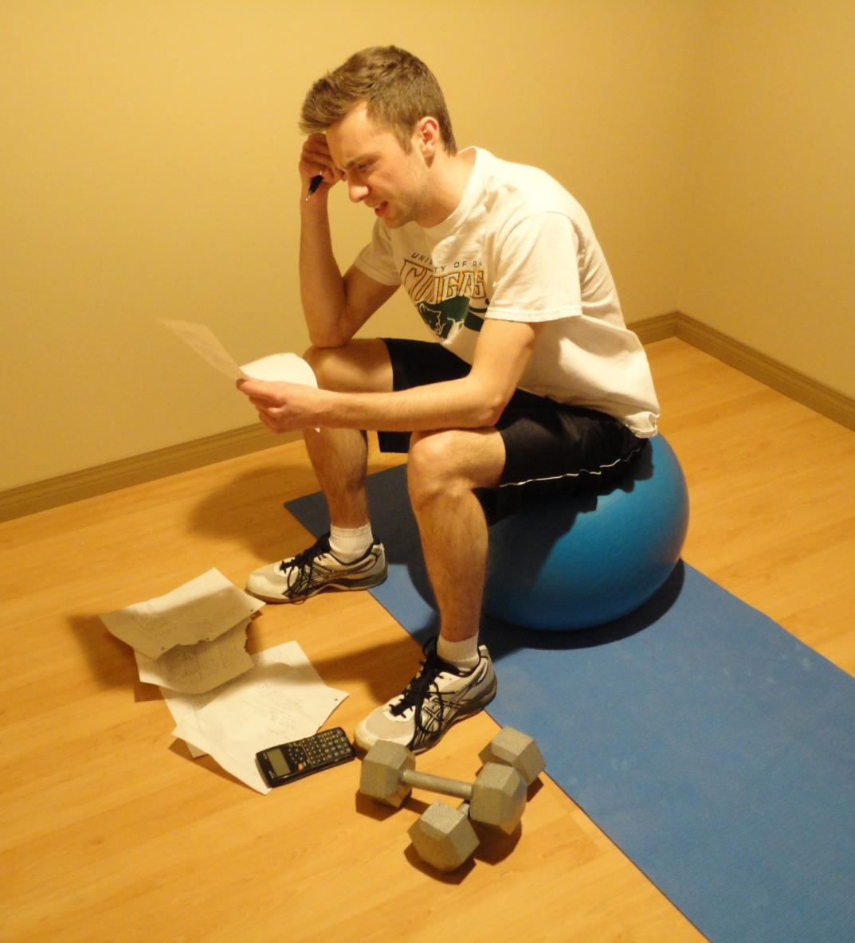
Problem Statement
Gym goers want to track their progress
Manually tracking weight training is cumbersome
Solution: design a system that automatically tracks weight training sessions
Other applications include monitoring the participants of research studies that involve prescribing weight training regimens to a large group of people
Notes:
https://www.indiegogo.com/projects/push-the-first-fitness-tracking-device-that-measures-strength

Slide 4
Objectives
Provide seamless weight training tracking
Allow users to log in to the device
Record reps, sets, weight, & time
i.e. measure distance/movement of the weight stack
Provide simple visual feedback to confirm activity is being logged and provide guidance on proper form
Display collected data on webpage

Slide 5
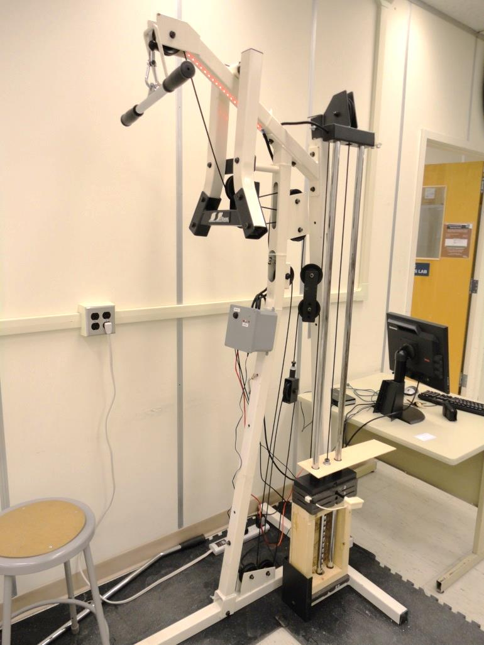
Scope
Gymtron is targeted to new gym goers who may not have proper form and need guidance
This is why a multi-purpose machine was chosen
New users are able to view their progress
Demonstrate proof of concept using a single exercise given limited timeframe
Webserver is intended for very light traffic to reduce costs
We disregarded scalability for this aspect of the project

Slide 6
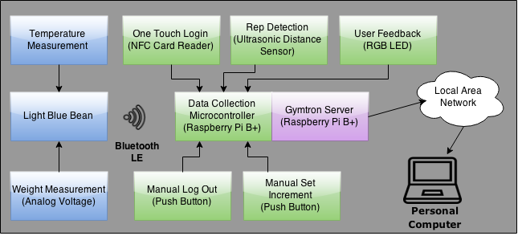
Block Diagram
Notes:
Kyle

Slide 7
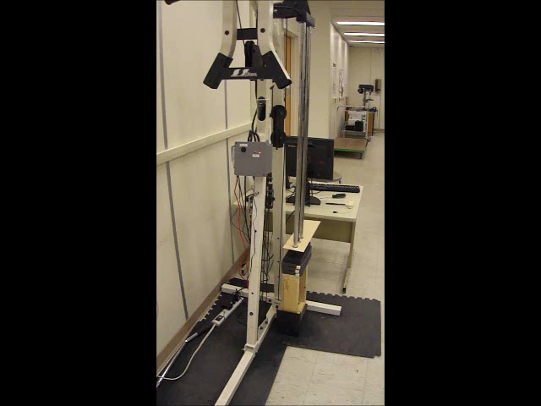
User Experience

Slide 8
Design Choices

Slide 9
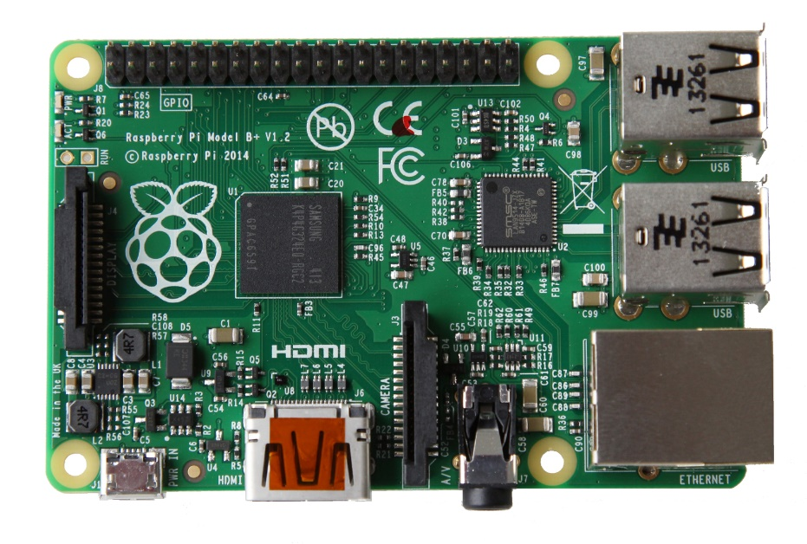
Processor
Looking for a cost-effective, flexible processor to handle data processing and serve web content
Decided on the Raspberry Pi B+
For $40, we could use a single Raspberry Pi to both gather and process the data as well as host the webpage
Very well supported, many different devices are easily integrated together
Many libraries available
Built in graphical user interface (GUI)
http://www.raspberrypi.org/introducing-raspberry-pi-model-b-plus/

Slide 10
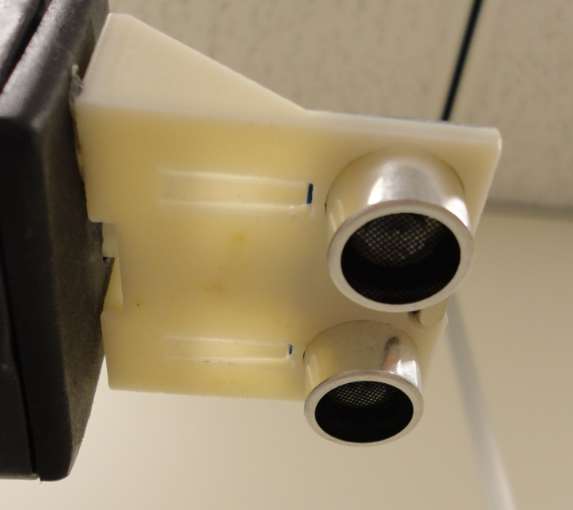
Rep Tracking
Required to measure the position of weight stack
Enough precision to ensure full range of movement
Measure fast enough to ensure LED strip feedback is smooth
Chose ultrasonic distance sensor
Bounces high frequency sound waves off objects in measurement range
Cost effective and easy to install compared to other sensors that provide distance information
15 – 20 degree measurement angle
Notes:
Kyle
Measure stack 10 times per second with median filter with a size of three (25ms delay between distance measurements)

Slide 11
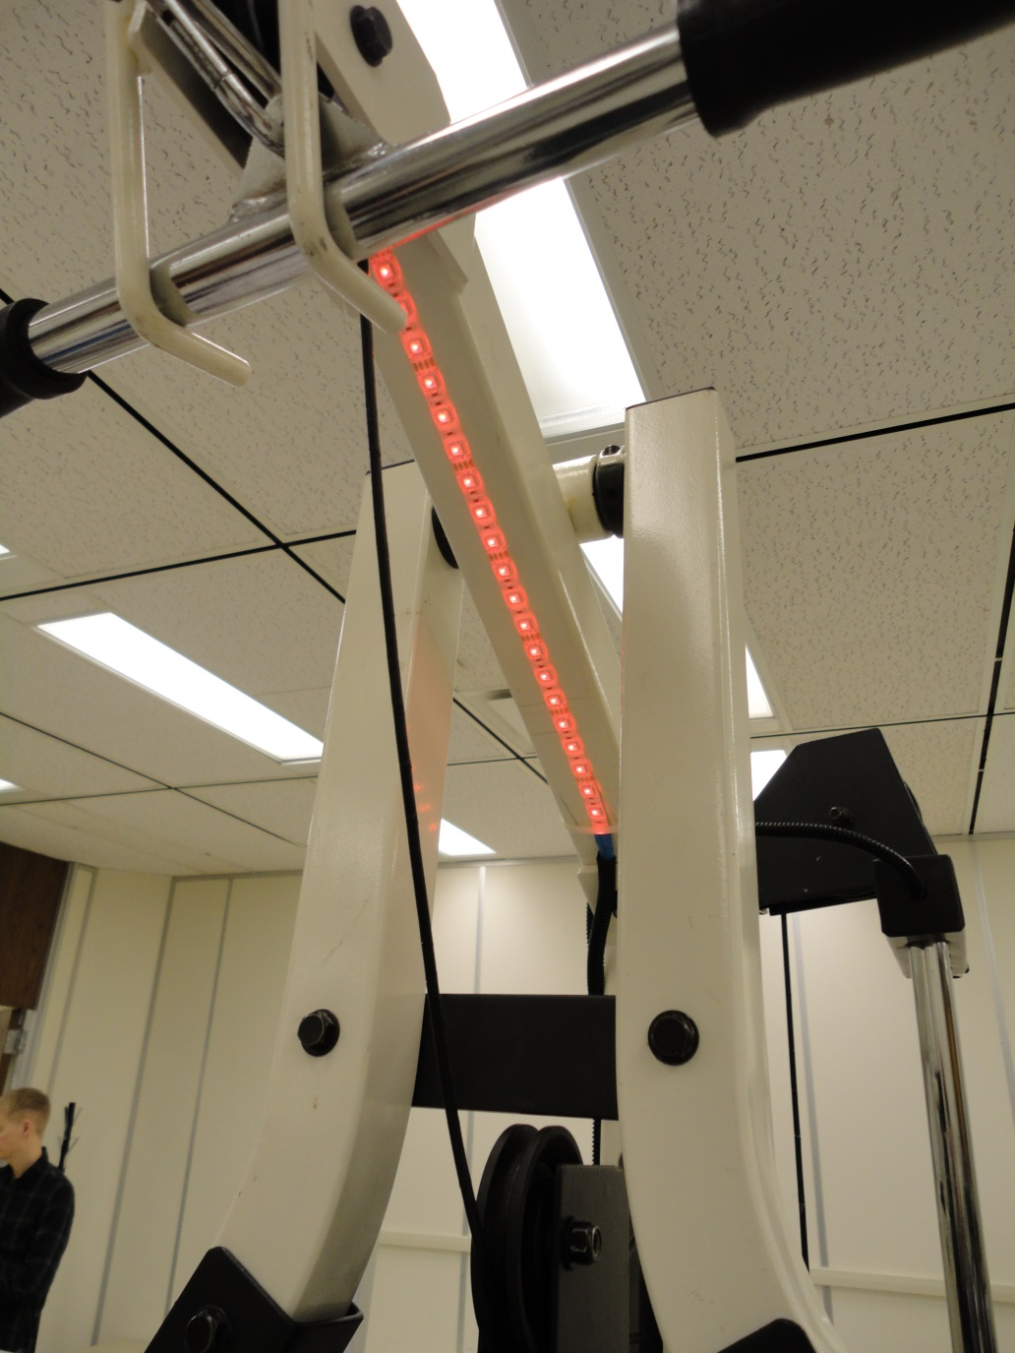
Feedback
Provide simple visual feedback to confirm activity is being logged and provide guidance on proper form
RGB LED Strip
Intuitive communication to user
Simple to implement and control
Notes:
With respect to the weight stack

Slide 12
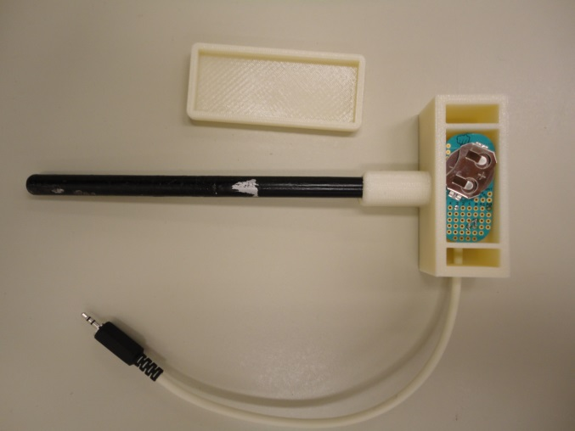
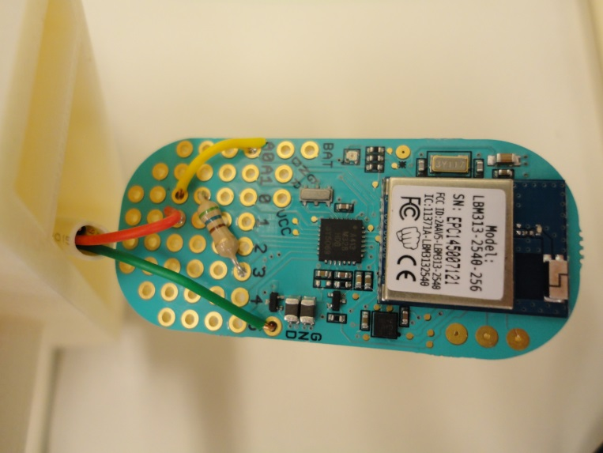
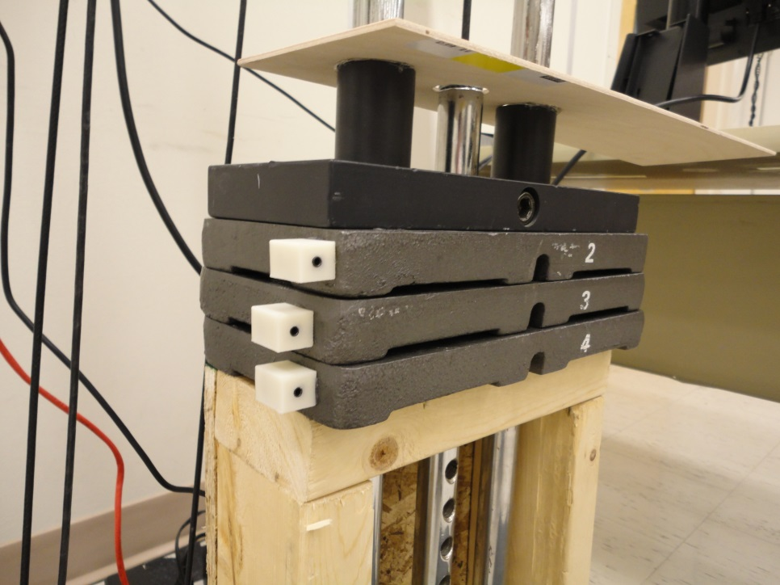
Weight Measurement
Determine which weight the user has selected from the weight stack
Traditional scale difficult to implement and likely to sustain damage from weights
Indirectly measure the weight via a unique resistance supplied by each weight
Solution: Light Blue Bean (LBB)
Bluetooth Low Energy module with microcontroller
Analog input measures unique resistance of each weight
Efficient battery use

Slide 13
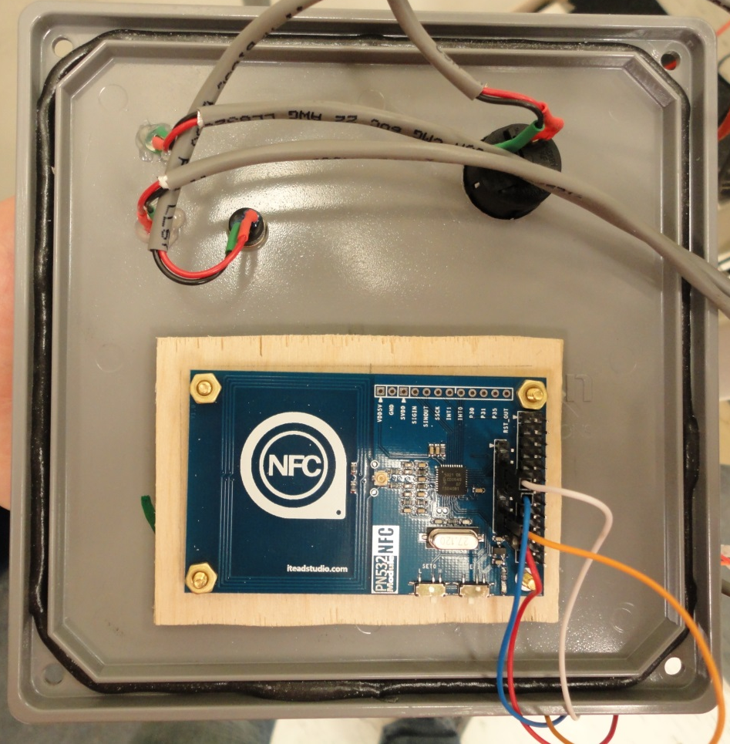
Login
Needed to identify user with little to no additional effort
Chose ITEAD NFC device
Allowed users to sign in with a single swipe of gym card
Users are already likely carrying their gym card already

Slide 14
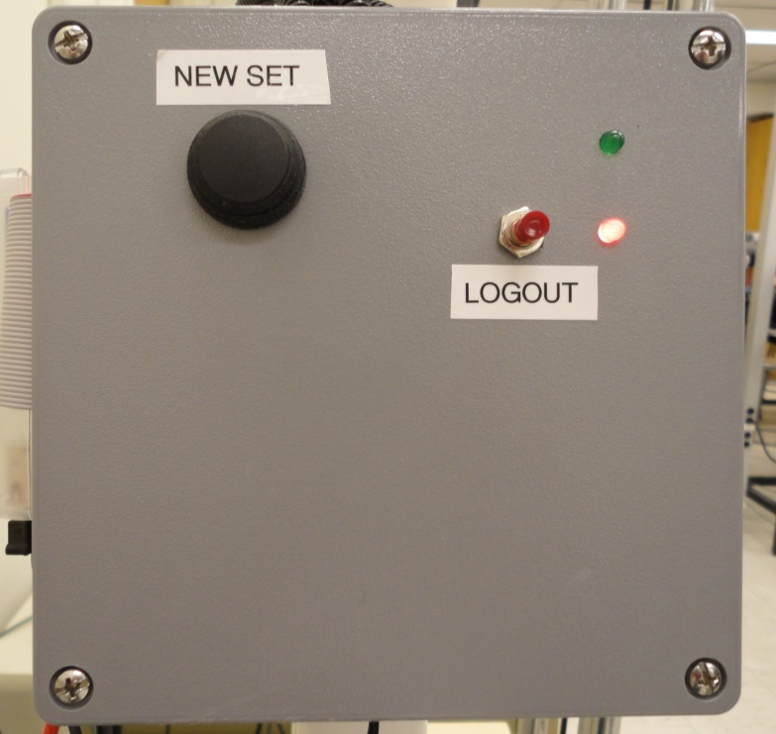
User Interface
Provide user with method to indicate the current set is complete
Button on the front panel for easy logout
LED’s on front panel indicate login status
Timeout feature to both automatically increment the current set and logout the current user

Slide 15
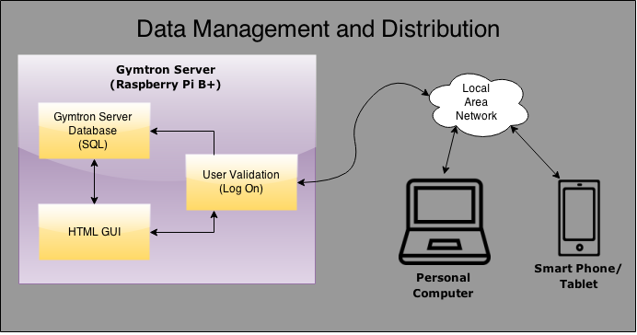
Webserver & Database
Used Raspberry Pi as the webserver
Needed to serve dynamic content via web browser
Needed to store all data in an easily accessible manner
Scripting allows any user to view personalized and dynamic content
Database allows storage of data, easily accessible through queries
Chose php for scripting and MySQL for the database
php and MySQL are very popular on today’s internet

Slide 16
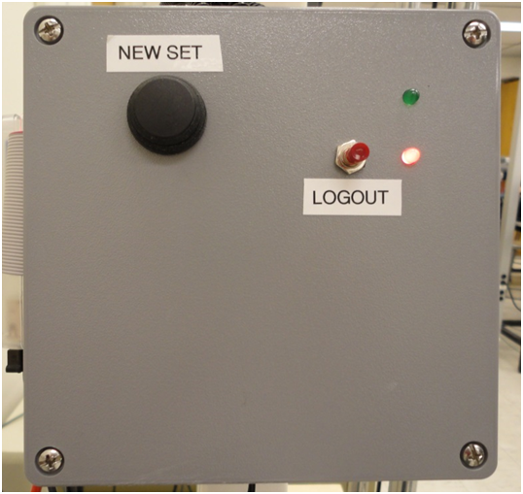
Challenges
Found original design relied too much on user performing workout with perfect timing
In addition to timing out, added buttons to indicate end of set and logout instead of relying on perfect timing
Added LED’s to convey status to user
Much more intuitive and simple for user
Sacrificed speed for ease of use

Slide 17
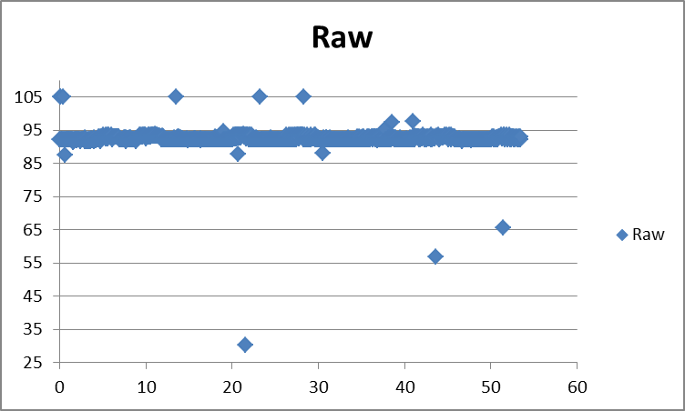
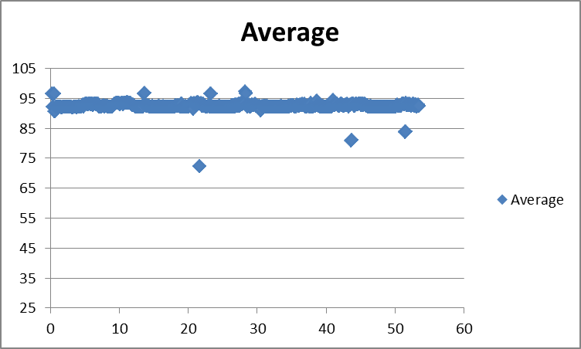
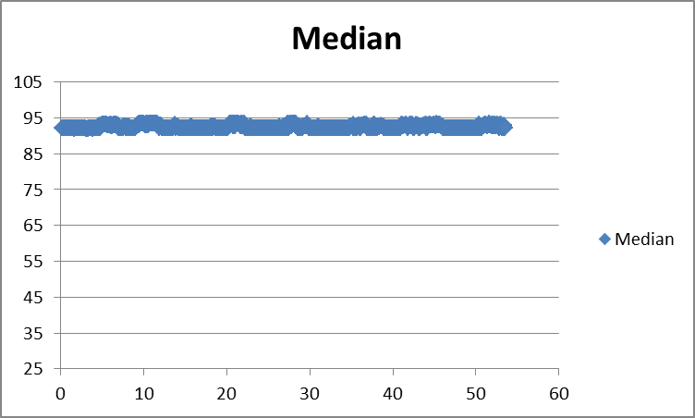
Challenges
Ultrasonic sensor data quality
Errors in the distance measurement caused unreliable operation
Analyzed data from the ultrasonic sensor in Excel
Implemented a median filter to improve accuracy
Notes:
Delay in control loop
Nice value, real-time scheduling algorithm (FIFO, RR), priority level
Become more informed about OS scheduling and recommended programming practices

Slide 18
Summary
Automated weight training tracker that makes user data available via a web interface
Used ultrasonic sensor, RGB LED strip, NFC card reader, and Raspberry Pi
Seamless integration with current workout routines
Interest in using system to track participants of research studies

Slide 19
Future Improvements
Implement a separate offsite server to store data
Safer, faster, scalable
Use WiFi for data transfer
Reduce cables present on machine
Add more exercises
Creation of customized user profiles and in-depth data analysis on webpage
Can consider physical differences and preferences between users
Improved weight stack tracking

Slide 20
Questions?

Slide 21
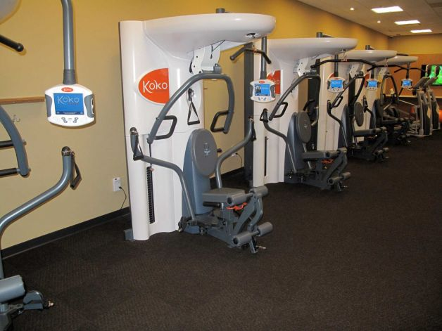
http://www.dariennewsonline.com/news/article/Koko-FitClub-brings-the-computer-age-to-the-local-3623193.php

Slide 22
